Slide 1
The ABC’s of Writing a Research Paper
Analysis of a Case Study
Author: Rhonda Lynn Doctor-Canham, B.S. MGS
Master Adjunct Faculty
Howard Community College
Columbia, Maryland
April 26, 2018

Slide 2
Definition & Purpose of a Case Study
A case study is a written document presenting the history, diagnosis*, clinical manifestations (signs & symptoms), prognosis (outcome), & treatment of a subject or subjects
* In some assignments the diagnosis will not be provided
The student will use information from the case study to form a hypothesis
A hypothesis is the statement of the student’s educated assumption of the diagnosis
Case studies are used to aid the student in gaining a better understanding of topics presented in Anatomy & Physiology
Some assignments may include a list of questions to help guide the research
Students will use a case study to write a research paper

Slide 3
Definition and Online Resources for a Research Paper
A written assignment focusing on a detailed examination & interpretation of the information & data presented regarding a specific topic
Link to HCC Library Research Help
The paper is written in American Psychology Association (APA) format & style
Typed
1 inch margins
Double spaced
Times New Roman 12 point font
Label each section of the paper
Abstract, Introduction, Hypothesis, Data, Discussion, Conclusion, References
Do not include the subjects’ name
Write in a formal voice
Do not use first-person pronouns ("I," "me," "my," "we," "us," etc.). (Rambo, 2012)
Use clear, concise language in an active voice (Prompt Writing Center)
Valuable Links:
Writing in a Formal Voice – The tone (word choice) used when an educated writer is communicating to an educated audience.
Formal Writing Style
HCC Library Cite & Write Home Page
HCC Library APA Home Page
OWL Purdue Online Writing Lab

Slide 4
Resource Guidelines for a Research Paper
In-Text Citations are Required
References must be no more than 10 years old
Reference of the course textbook is required
Reference of websites
No more than TWO (2) website references are permitted
Use APA format to cite the website
Creating a reference page in a Microsoft word document
On a separate page, centered type “References”
Click Reference
Select APA
Click Insert Citations
Select Add New Source
Select the type of Source
Place a Check Mark in the box labeled Show All Bibliography Fields
Type all required information in the appropriate field

Slide 5
Content Required in a Research Paper Center All Headings
Title page
On a separate page include title, author, institution, date optional
Abstract
On a separate page write a brief summary of important points
Highlights of the case
List of Key Terms (OPTIONAL)
Introduction
On a separate page
Purpose
Background information
Definition of Key Terms
Hypothesis
Data/Results
Labeled data tables
Labeled data graphs
Create tables & graphs with Excel or Microsoft word

Slide 6
Content Required in a Research Paper continued
Sample Data Table
Contact the LAC for assistance to create graphs in the document
Table Title
Subject/Independent variable with units
Dependent variable with units
Data

Slide 7
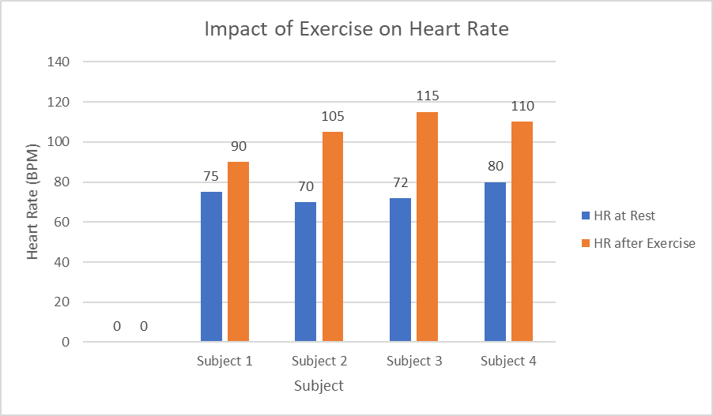
Content Required in a Research Paper continued
Sample Graphs
Graph Title
Y Axis dependent variable with units
X axis subject/independent variable
with units
Legend

Slide 8
Content Required in a Research Paper continued
Discussion
Accept or Reject the hypothesis – Relate the hypothesis to the background information
Answer all questions in the case study
Refer to the Rubric
Analysis & Interpretation of data
Provide a detailed explanation of all data presented
If applicable, compare the test subject to the control
Determine if the signs & symptoms (data) fall within normally accepted parameters
Explain why data is below or above normally accepted parameters
Describe treatments and how each treatment improves clinical manifestations of the diagnosis
Conclusion
Brief Summary of findings
Include areas of uncertainty
Include suggestion(s) for further research
Reference page
On a separate page list all sources

Slide 9
Assistance in Proofreading a Research Paper
Read the document “out-loud” paying close attention to punctuation and size of font.
Request someone else to read the document
Microsoft Word document Proofreading tools
Setting rules for Microsoft Word Documents
Select File
Select Options
Select Proofing: Microsoft will inspect those items that have a check mark in the box
Locate item When Correcting Spelling & Grammar
Select Grammar & more
Select Settings
Microsoft will inspect those items that have a check mark in the box
Checking the Document
Click Review
Select Spelling & Grammar
Follow spelling & grammar suggestions as appropriate
Note that Microsoft does not contain all scientific terminology

Slide 10
Instructions to Submit an Assignment
Submit papers to Canvas
HCC uses VeriCite to inspect student papers for originality
IT HELP Desk Recommends: GOOGLE CHROME
Type of FILE TO SUBMIT: MICROSOFT WORD DOCUMENT
Select Assignments
Click on the Assignment
Click submit Assignment
Locate File Upload
Click Choose File
Select the document to submit
Select Another File to submit more than 1 document for this assignment
Place a check mark in the box “ I certify that I have read….
Click submit Assignment
VeriCite Submission

Slide 11
Instructions to View Graded Assignment
Open the Course Canvas site
Select Assignments
Click on the assignment
Click Submission details
Click View Feedback
Contact the Help Desk for assistance
VeriCite Review

Slide 12
The ABC’s of Writing A Research Paper
ACCEPT the challenge NO typos
BEGIN the assignment ORGANIZATION follows guidelines
CITATIONS are in-text PROOFREAD
DUE DATE QUESTIONS are answered completely
Edit Extraneous information REFERENCE of course text book is required
FORMAT is APA SUBMISSION to canvas
GRAMMAR TIMELINE
HYPOTHESIS USE resources
INTERPRET data VALIDATE conclusions
JOIN a peer review group WEBSITE use is limited
KEEP calm X-AXIS labeled with 1 type of units
LITERATURE is recent Y-AXIS labeled with 1 type of units
MY originality score ZERO tolerance for plagiarism
(Canham, 2018)

Slide 13
References
Canham, R. L. (2018).The ABC’s of Writing a Research Paper. Ellicott City, Md
Howard Community College. (2018). Library. Available from http://howardd.libguides.com/homepage
Prompt Writing Center. Retrieved from http://writingcenter.prompt.com/formal-writing-style/
Purdue University. (2018). Owl Online Writing Lab. Available from http://owl.English.purdue.edu/owl/resource/560/8/
Rambo, Randy. Illinois Valley Community College English Composition 1. (2012) Retrieved from http://www2.ivcc.edu/rambo/tip_formal_writing_voice.htm

