Slide 1
Good- Bye Summer 2020
Hello Fall Semester

Slide 2
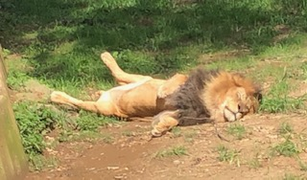
Energy High As Semester Begins

Slide 3
Looking At All We Have Done
Online versions of your courses (ESL and DEV)
New techniques (technology such as Voice Thread, “ungrading,” and virtual library assignments).
New OER and Canvas materials, 121 and INFO 100
GSP
Teach Online completion
Evaluation of digital annotation tools – Karen/Juliette
Humanities grant/COIL/Rethinking International Education
The list goes on….

Slide 4
HCC EGWL Jeopardy
Time to “refresh”
Breakout with list of questions
10 minutes to get as many answers as you can
One person keeps track of answers
When we return, one person puts your team total in chat box

Slide 5
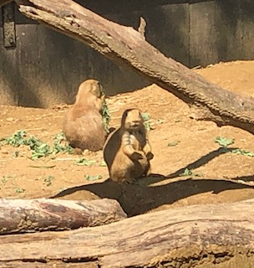
Looking Ahead

Slide 6
Our Community Work
Continue to share
Launch Pathways
Cultivate conversations – October group
Incorporate new general education goals
Prep for Middle States
Celebrate no Baldrige!

Slide 7
Phase 2-3?

Slide 8
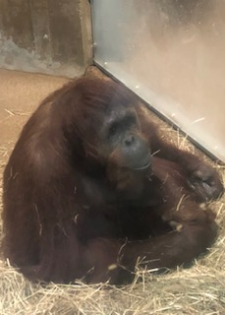
Fighting That Lost Feeling

Slide 9
Resources
Melodie Gale
Associate Director of Learning Assistance Center/Completion Services

Slide 10
Comforting Thoughts
Promotions and Sabbaticals
Nancy (plus pronunciation lab info)
William
B4C

Slide 11
Drive-By Info?
Parking Lot A
Last row (towards Little Patuxent Parkway
Text Margaret – 410-294-1234 if questions

Slide 12
Best Wishes for Fall 2020
Be well.
Let us know if we can help.
Be flexible.
Thank you.

